Slide 1
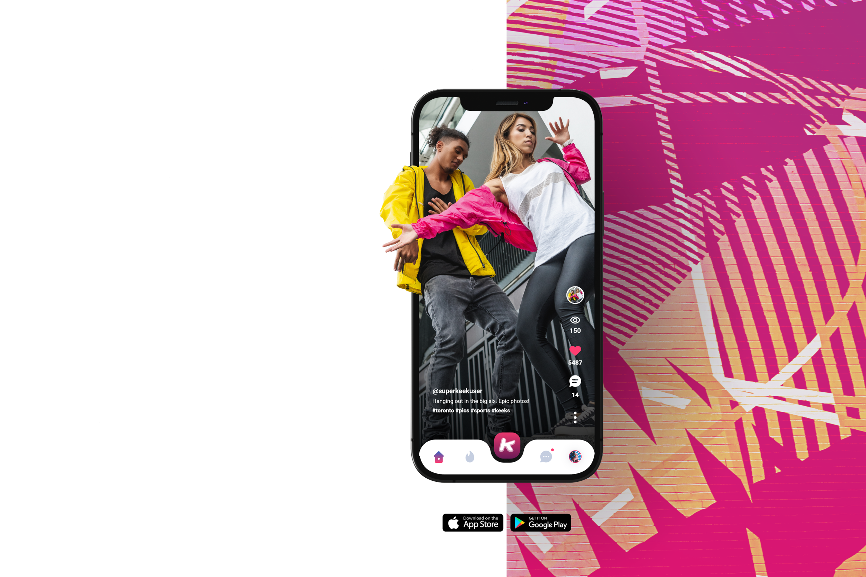
Corporate Presentation 2023
Keek Social is a subsidiary of Personas Social Incorporated. Toronto, ON. Canada.
www.keek.com

Slide 2
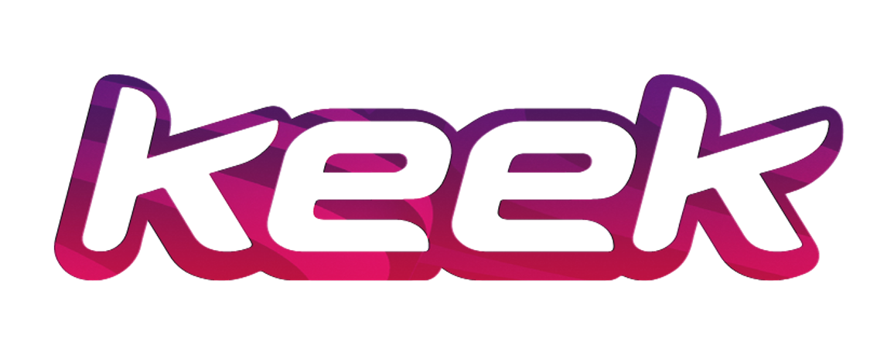
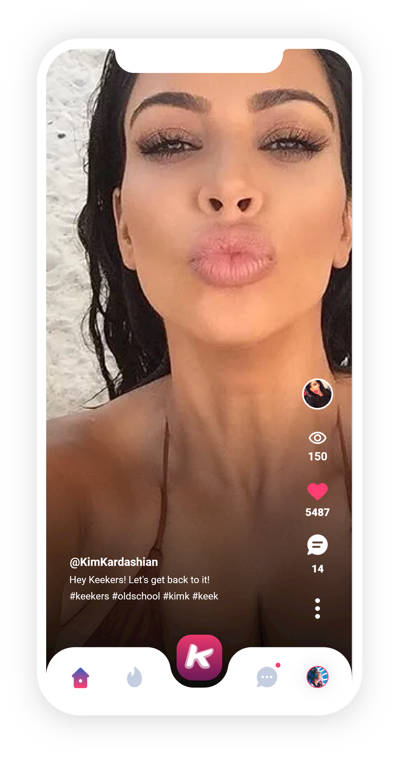
How it all started.
Pre-dating Tik Tok, Keek was the original short form video app.
Debuting in 2012 and supported by the Kardashians, Keek garnered a global audience of 80 million users in 180 countries. Keek users have gone from high-school to their 20s; from college to careers and they all want their Keek back.
In the light of rumors of foreign government spying and in the shadow of divisive and toxic social media; the desire for the fun carefree days of social media has created a groundswell of people asking for their Keek back.
So, due to overwhelming demand Keek is back and better than ever!
"Please cast your mind back to a time before Instagram Stories, before Snapchat, and even before Vine—when a little somethin' somethin' known as Keek was the social media platform to document your life on."
Mehera Bonner, Marie Claire 2019

Slide 3
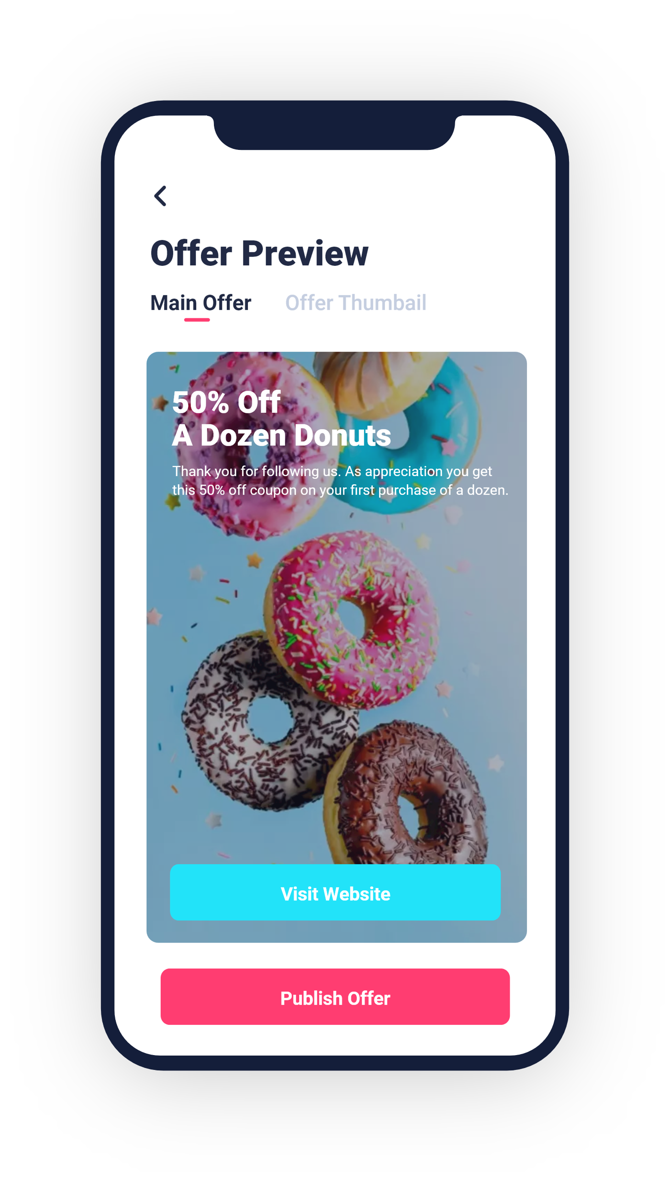
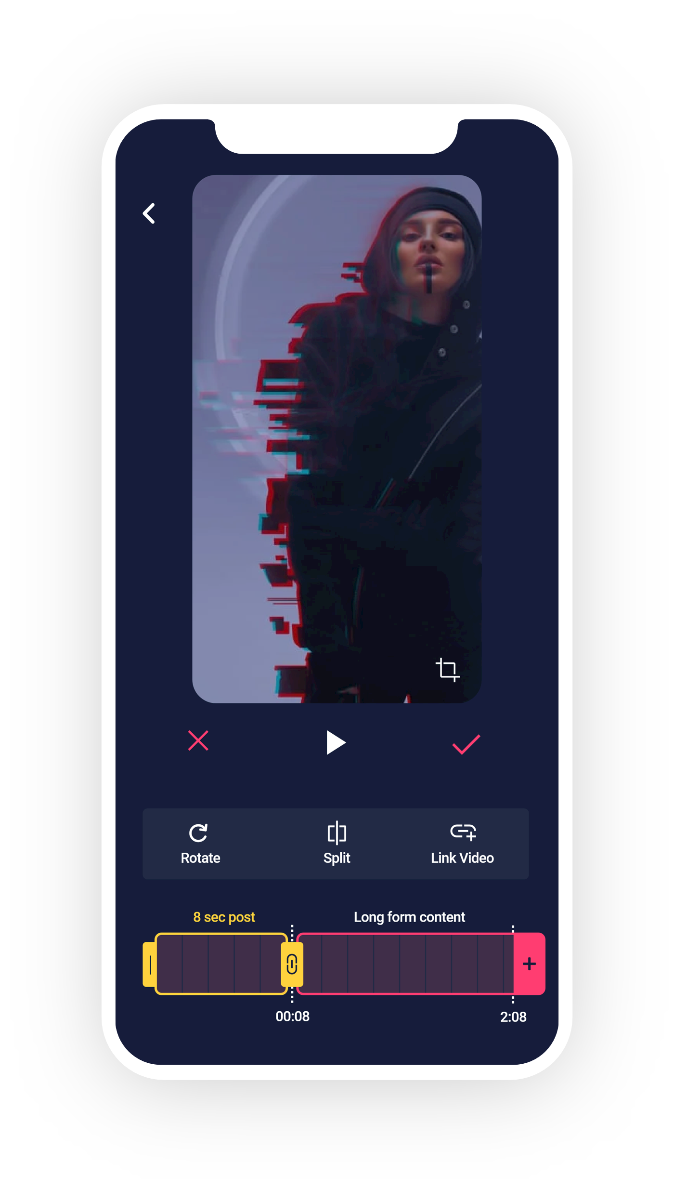
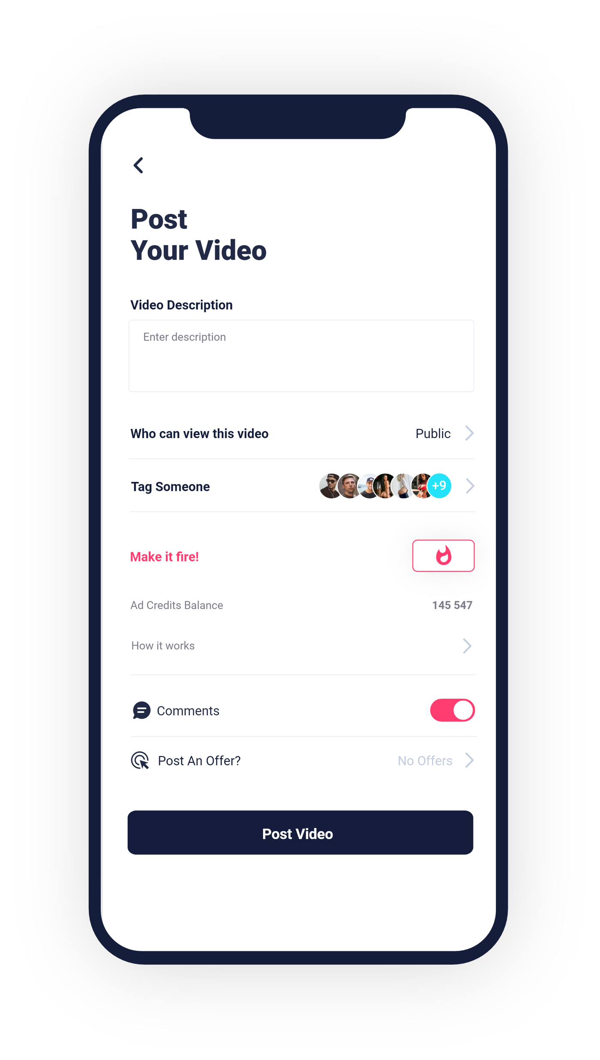
New Features.
"The main reasons people use social media is to stay in touch with friends and family,
ﬁll spare time, and read the news."
Source: Hootsuite’s Digital Trends Report 2022.
Keek gives users what they really want from
Video Editing
their social networks.
Fire Posts
Offer Box
Keek allows you to create
In addition to masks and ﬁlters, we offer one of the most advanced mobile-video
The new Keek boasts advanced AI tech that power its Fire Posts™. Fire
interactive pop-up offers that appear on your posts. The offers are easy to create and can link to virtually anything.
editing suites in the market today. We want to make sure our content creators have all the tools they need to create amazing content.
Posts use AI to insert your posts into the feeds of people most-likely to follow you. You can build an audience and get famous and monetize your fame with our Offer Box.

Slide 4
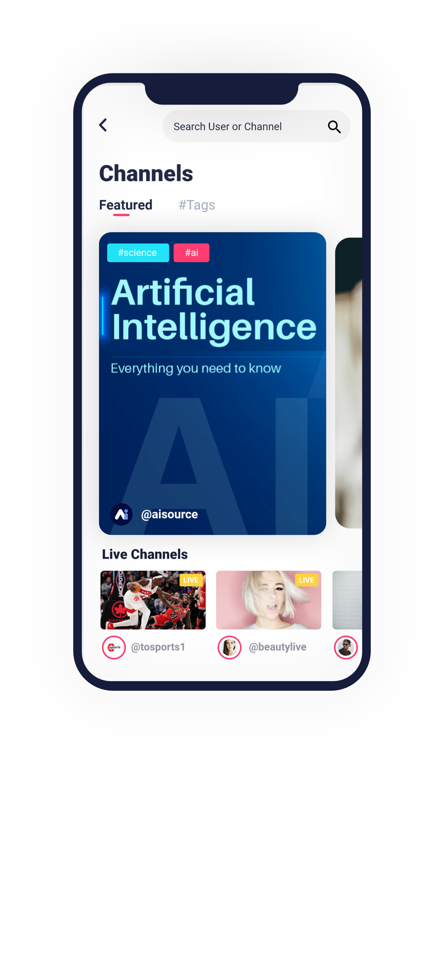
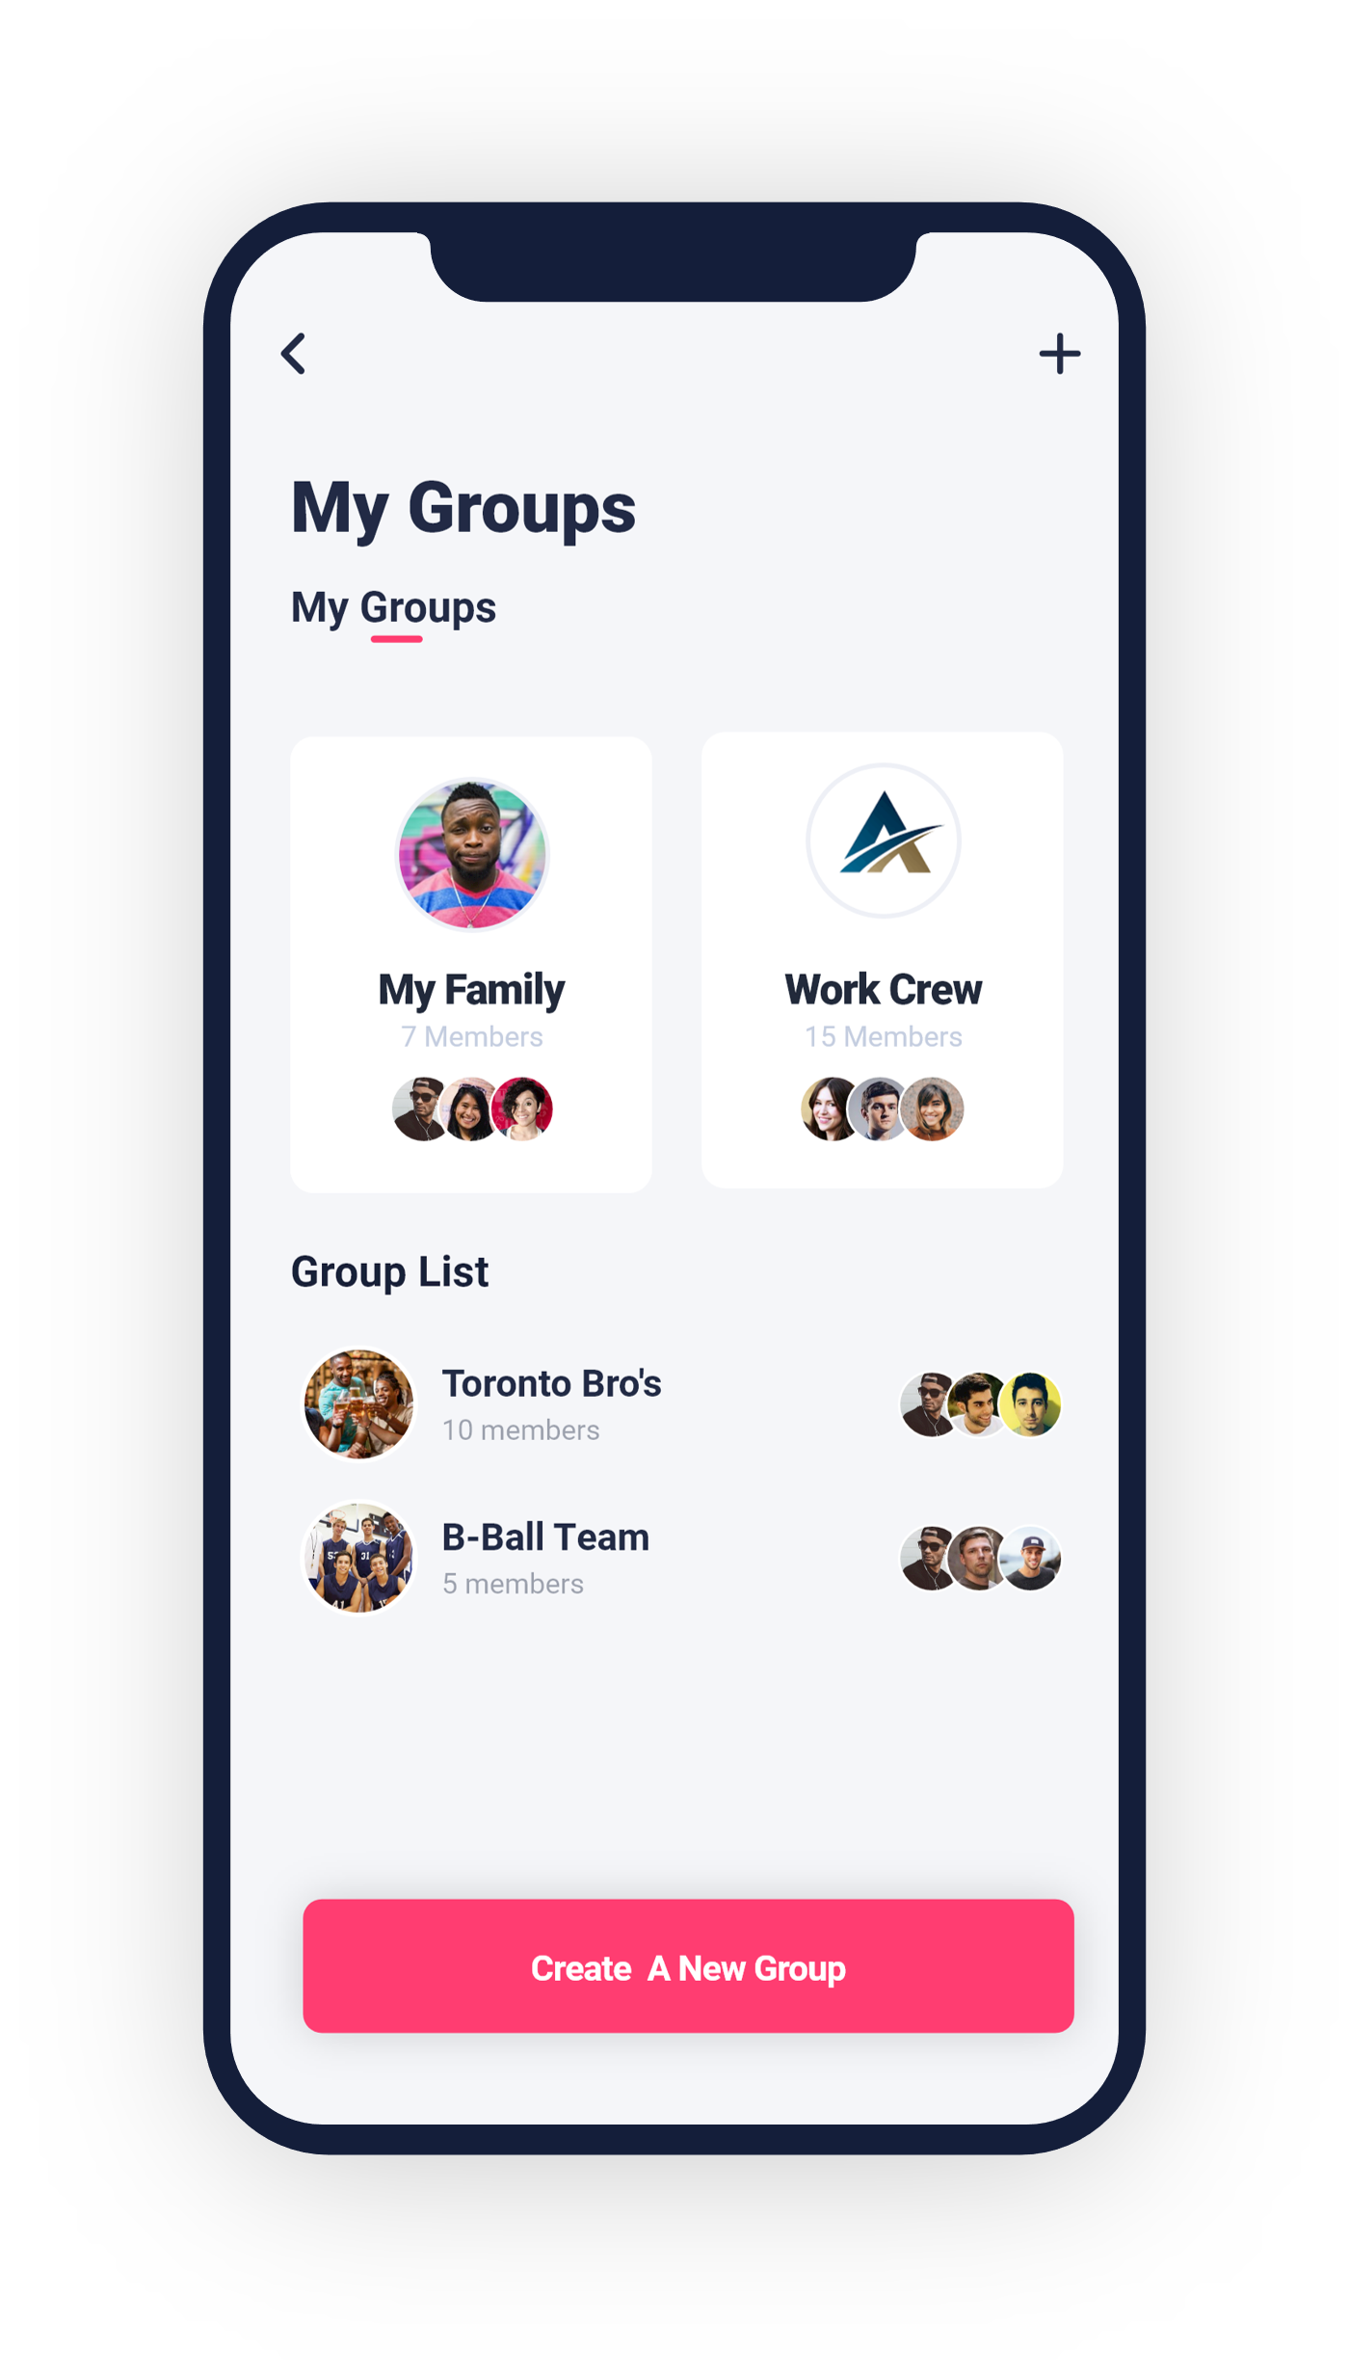
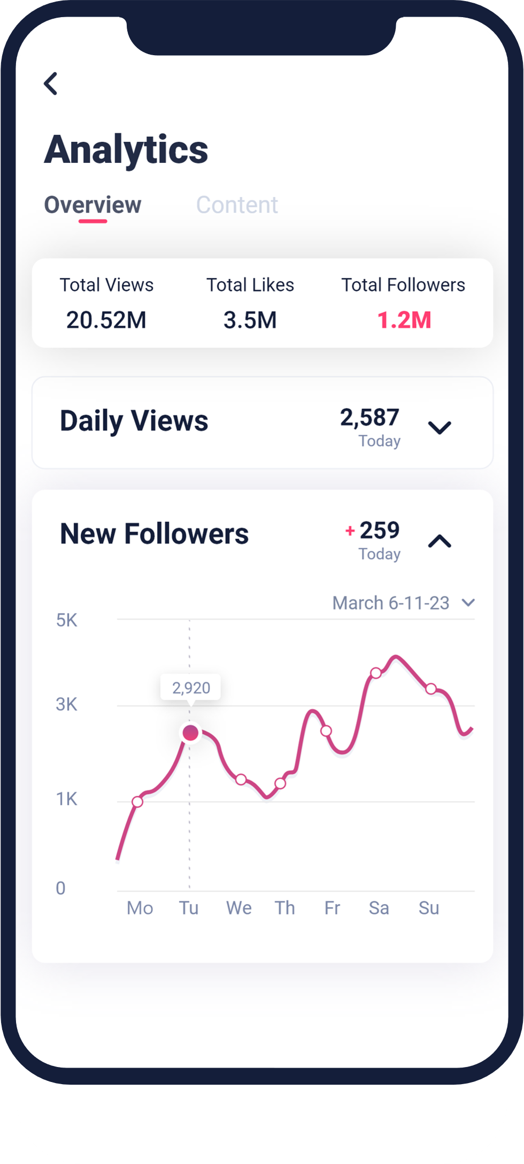
Features Continued.
Channels
In addition to random user generated content, Keek also curates high-quality content for busy people with busy lives, who just
Groups
Keek protects your privacy and lets you stay in touch with family and friends by allowing you to create
Creator Analytics
Performances statistics to help creators ﬁne tune their content offerings.
groups.
want to see the best of what's online.

Slide 5
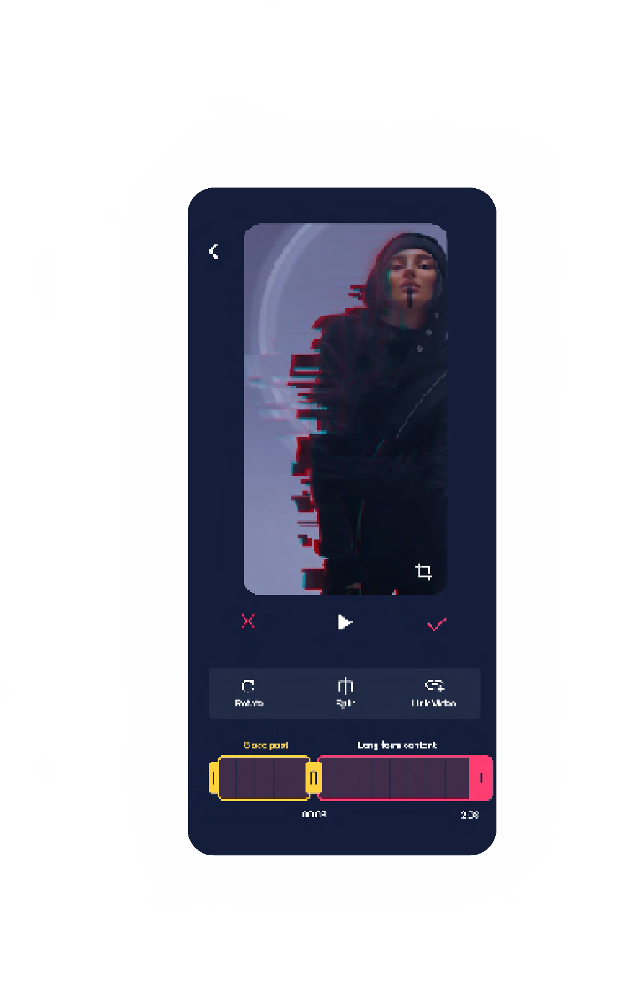
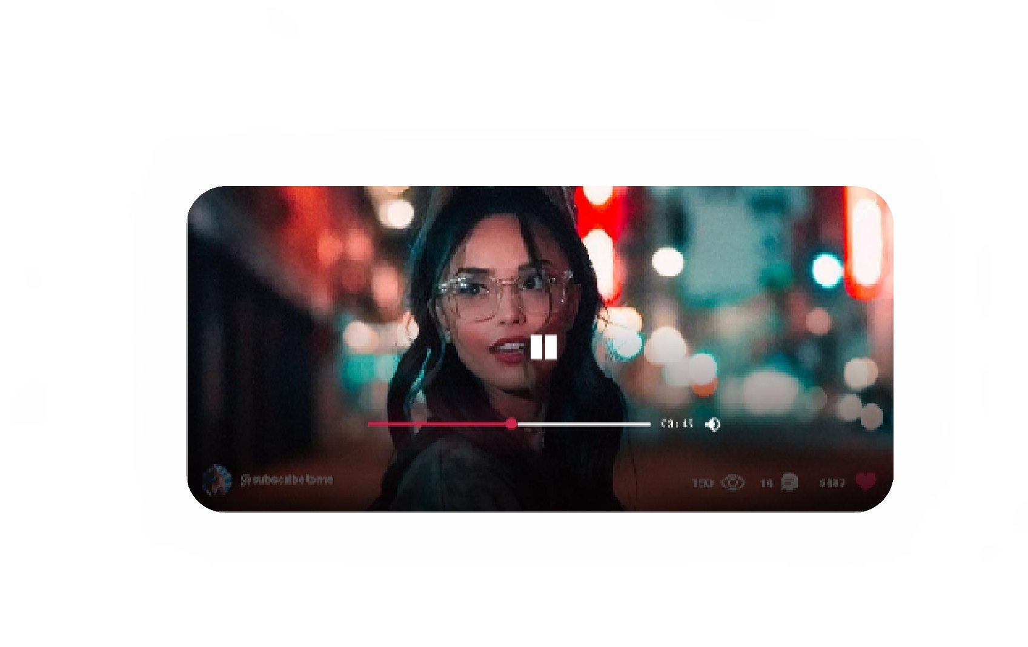
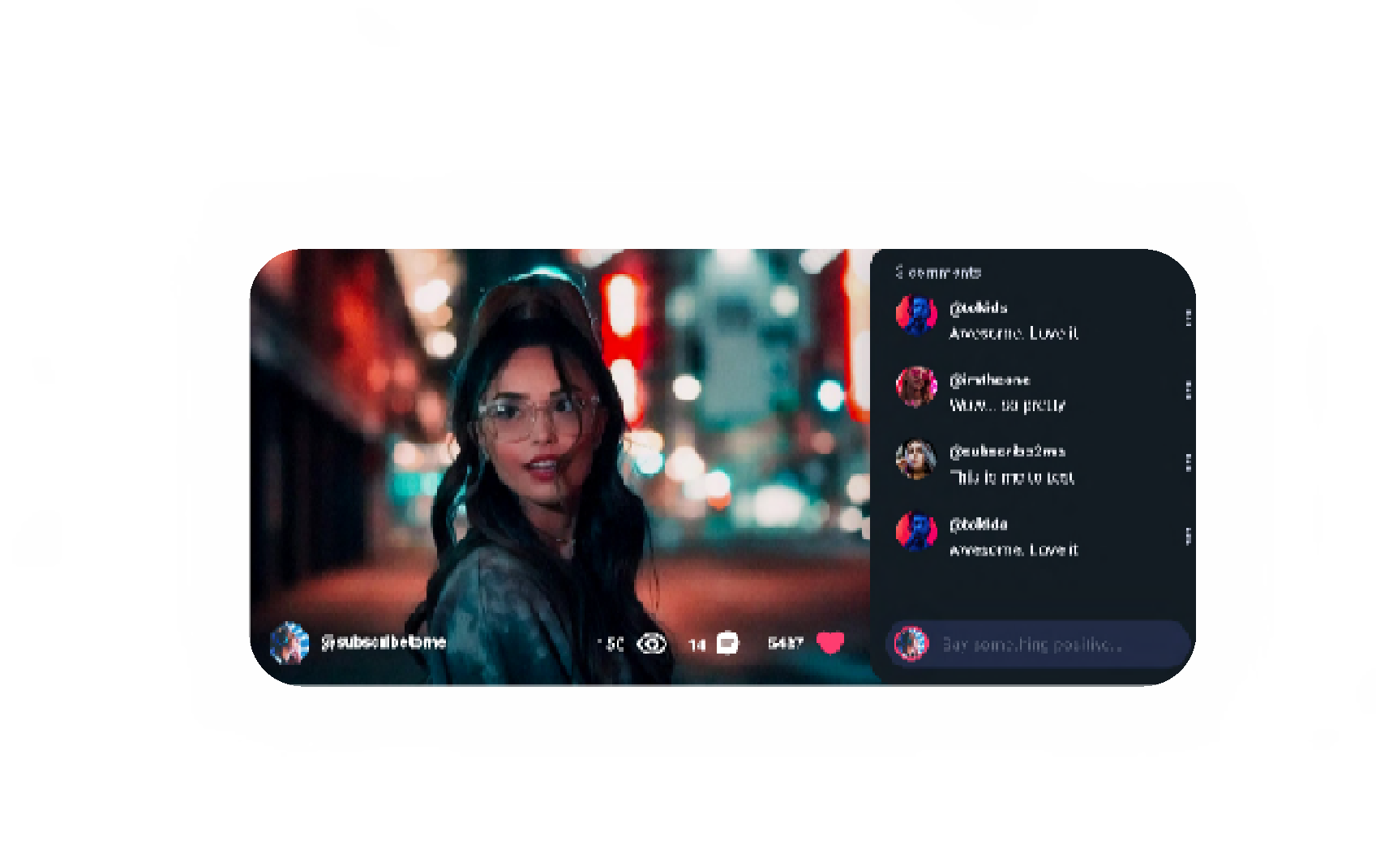
More Features.
Link
A Video
You now have the ability to link another video to your 8 second post.
Use your post as a trailer for other long forma content up to 60 minutes.
t
Link to Longform Content
In addition to 8 second vertical scrolling Keeks,
Keek also allows user to enjoy beautiful high-deﬁnition landscape-oriented videos.

Slide 6
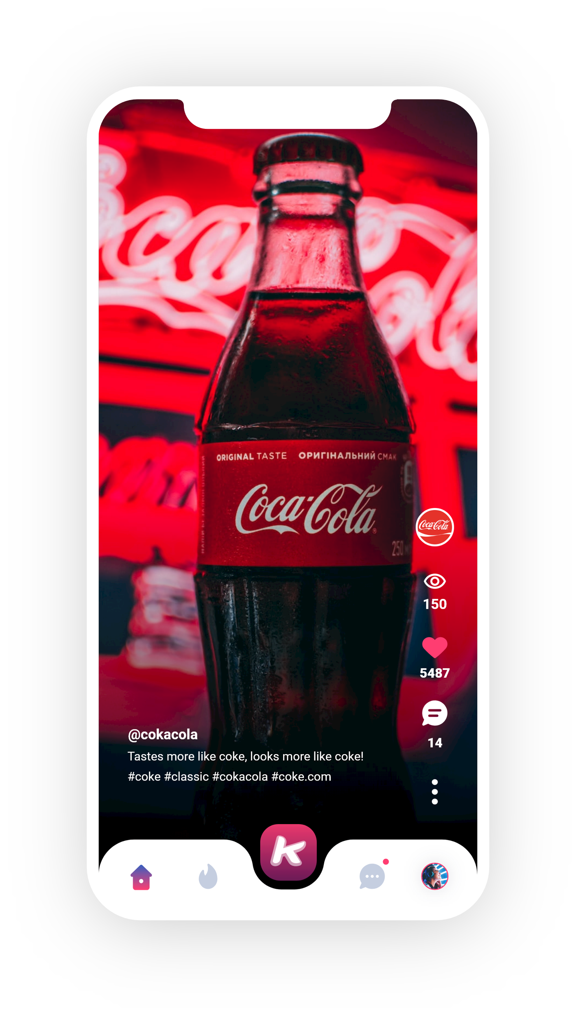
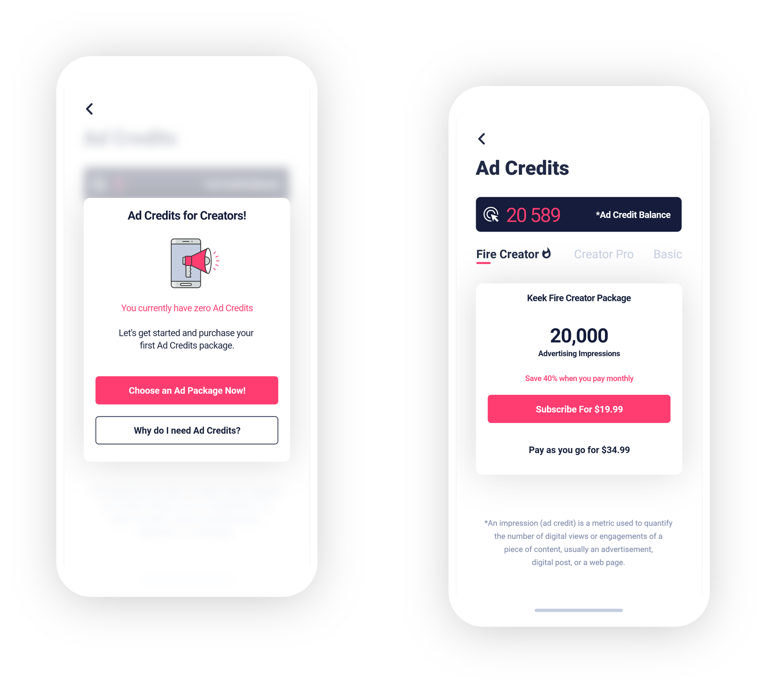
Revenue Model.
Advertising Credits
Keek charges its users to use Fire Posts on the Keek platform.
Advertising
Advertising is sold as advertising credit packages. Advertising Credit Packages range in price from $7.99 to $74.99 and are sold as either one-time purchases or as subscriptions.
Keek has 5 different advertising units
in which it sells advertising to sponsors: Feed, Pre-Roll, Mid-Roll, Post-Roll and Channels.
Users are offered a discount for subscribing to Ad Credits Packages.

Slide 7
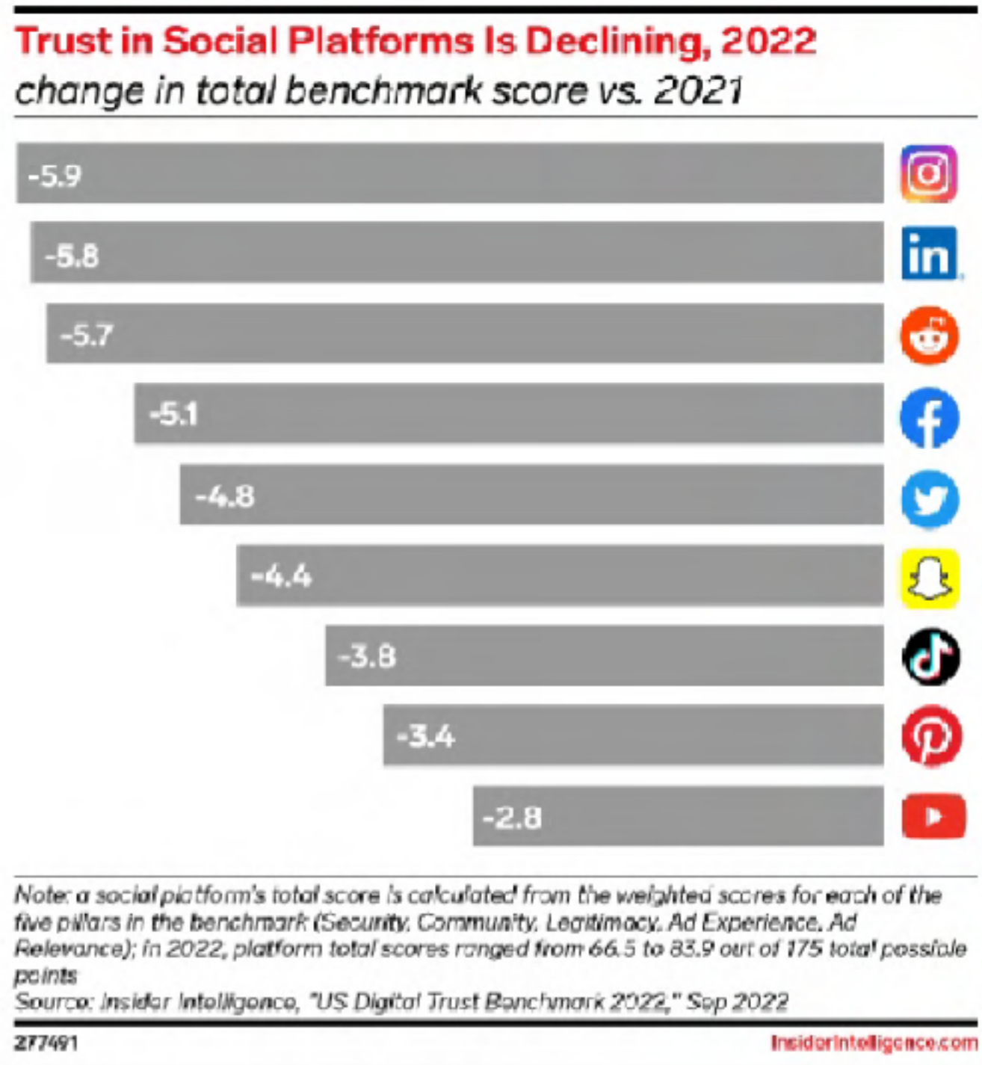
Market Landscape.
Growing distrust in existing social media platforms coupled with an outright banning of Tik Tok by numerous governments and addition billion people joining social media in the next few years; creates a huge market opportunity for Keek.
The number of social media users worldwide has swelled to a record 4.9 billion people globally. What’s more, this number is expected to jump to approximately
5.85 billion users by 2027. Source Forbes 2023
Overall user distrust of social media grew in 2022.
Source: Insider Intelligence 2023
Tik Tok is either fully or partially banned in 16 countries comprising a population of almost 3 billion people so far and counting.
Source Mashable By Meera Navlakha on May 18, 2023

Slide 8
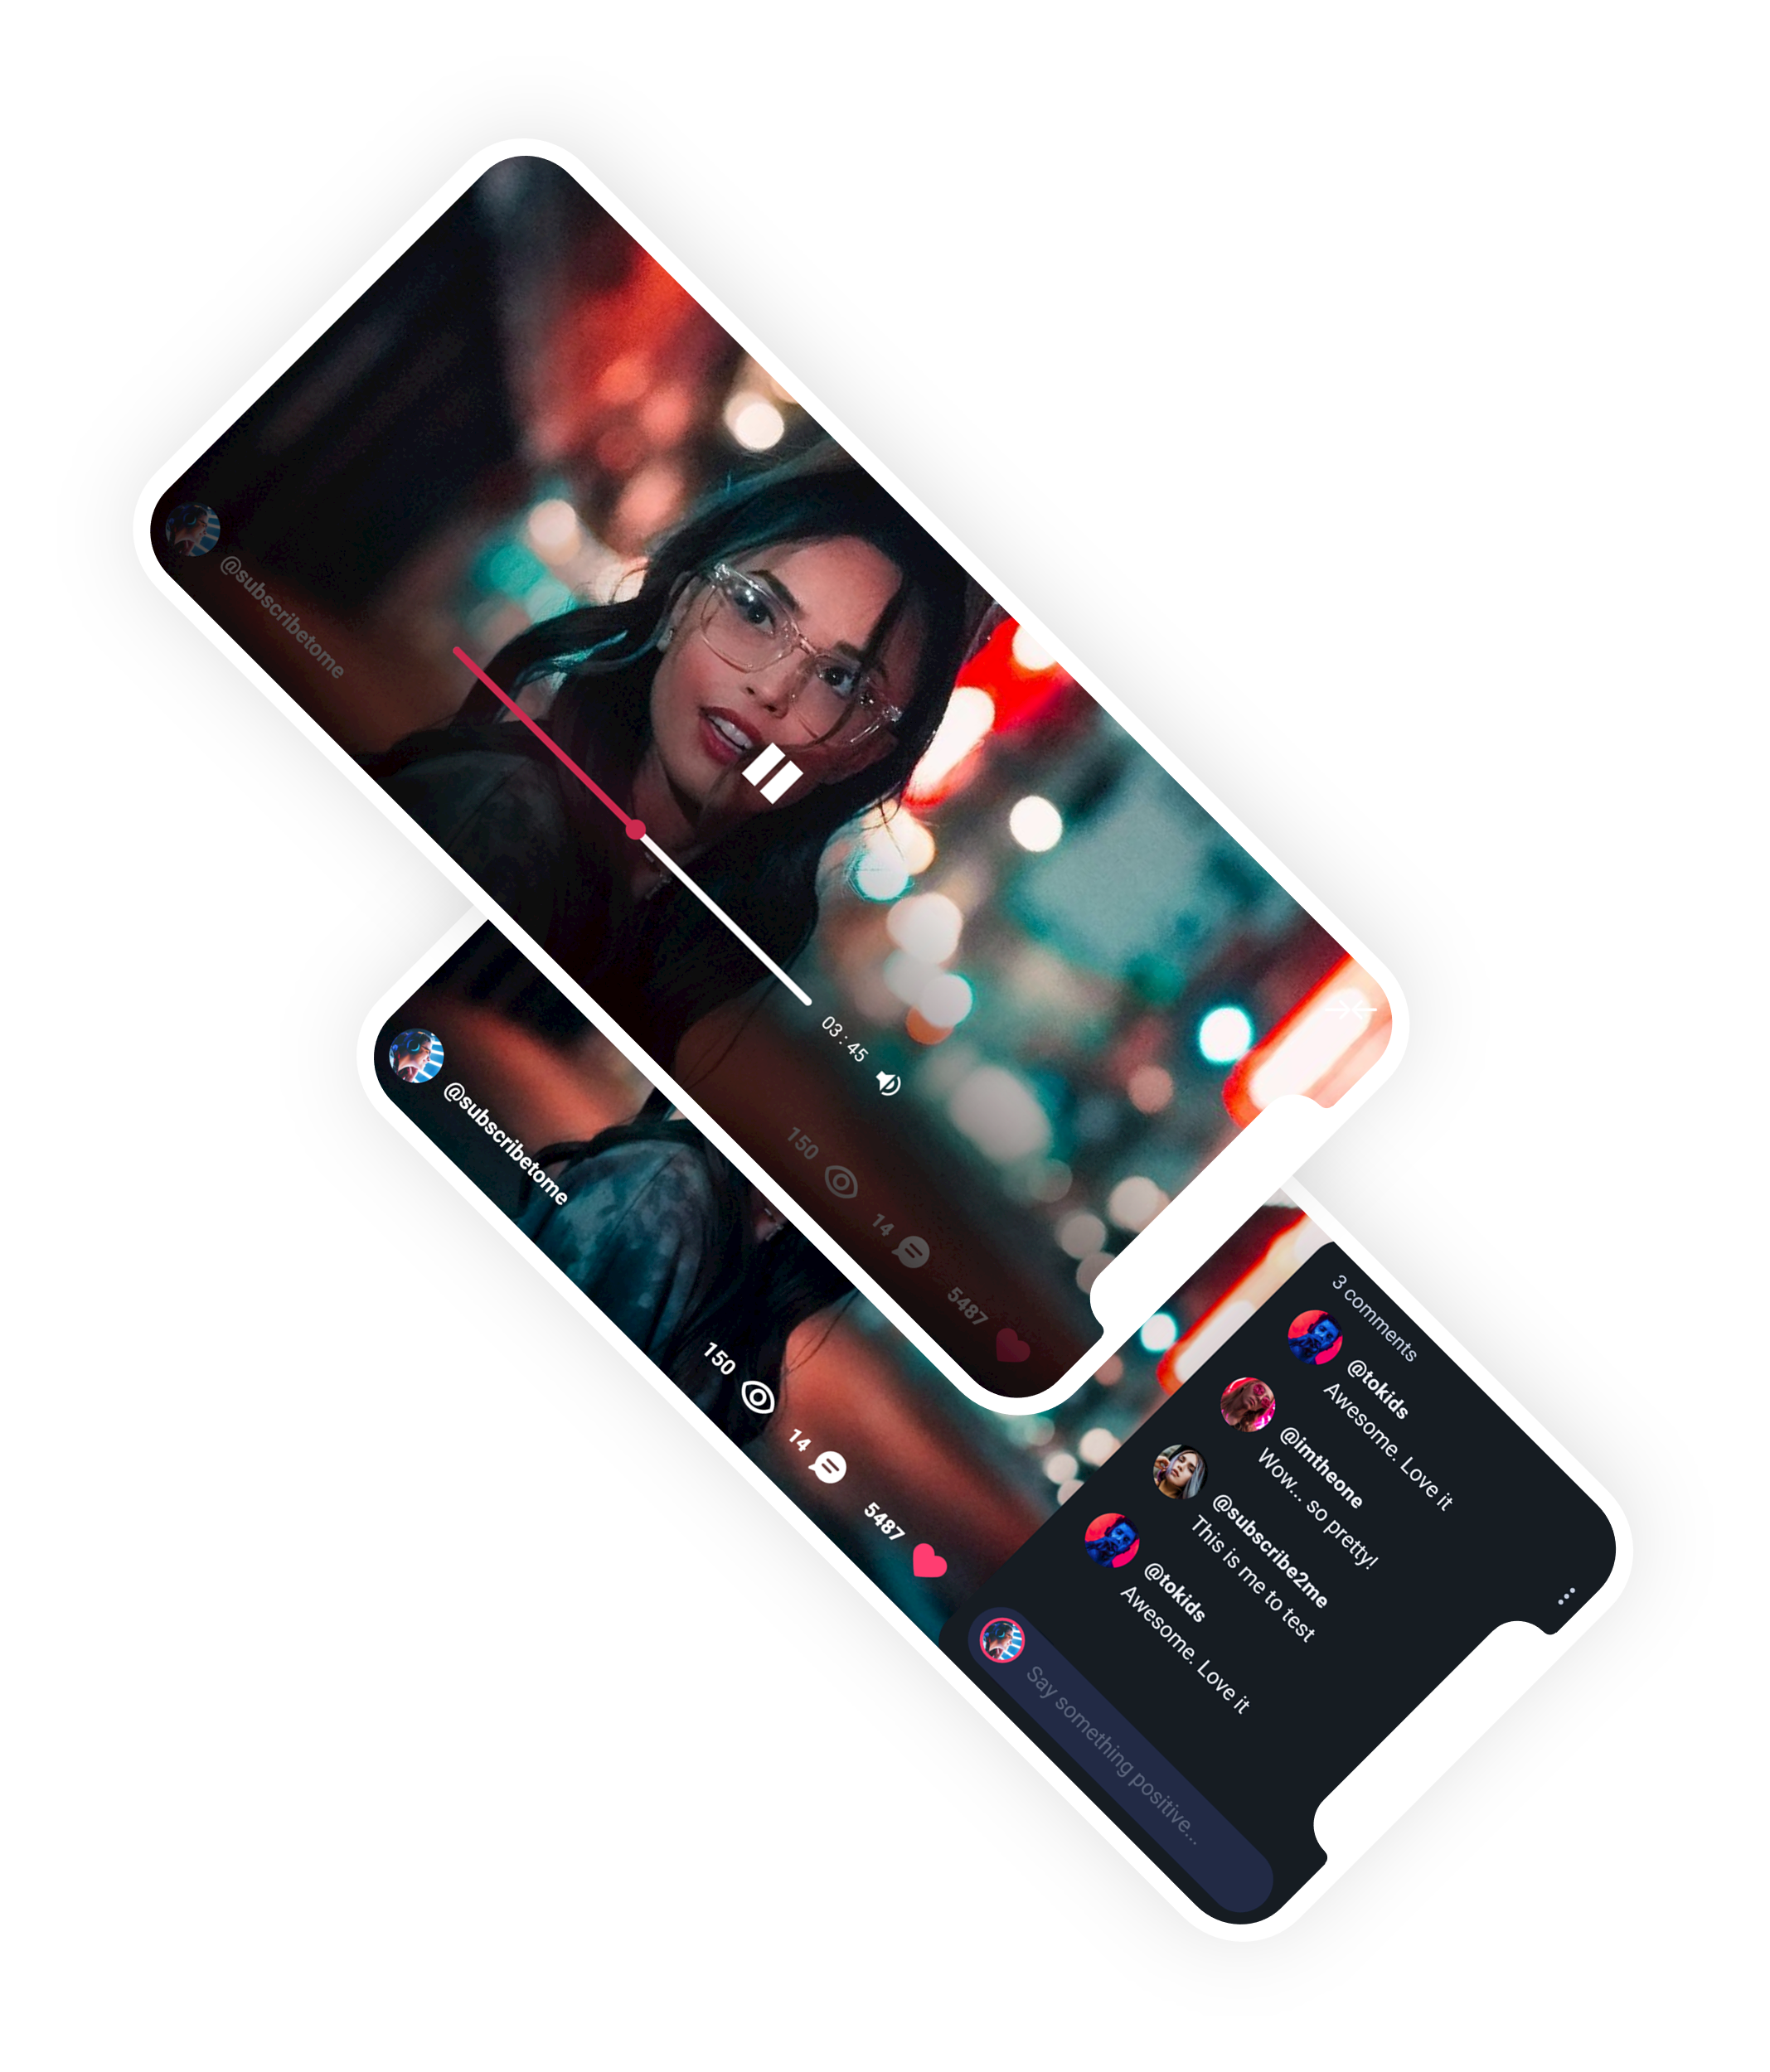
Market Landscape.
Longer form content still rules the day with YouTube getting 82% of teens and young adults compared to 24% for Tik Tok.
In a 2020 study from Statista, it was discovered that 82% of teens and young adults (ages 15-25) in the UK were using YouTube to consume video content. This made the video sharing platform more popular than Facebook, WhatsApp, and Instagram.

Slide 9
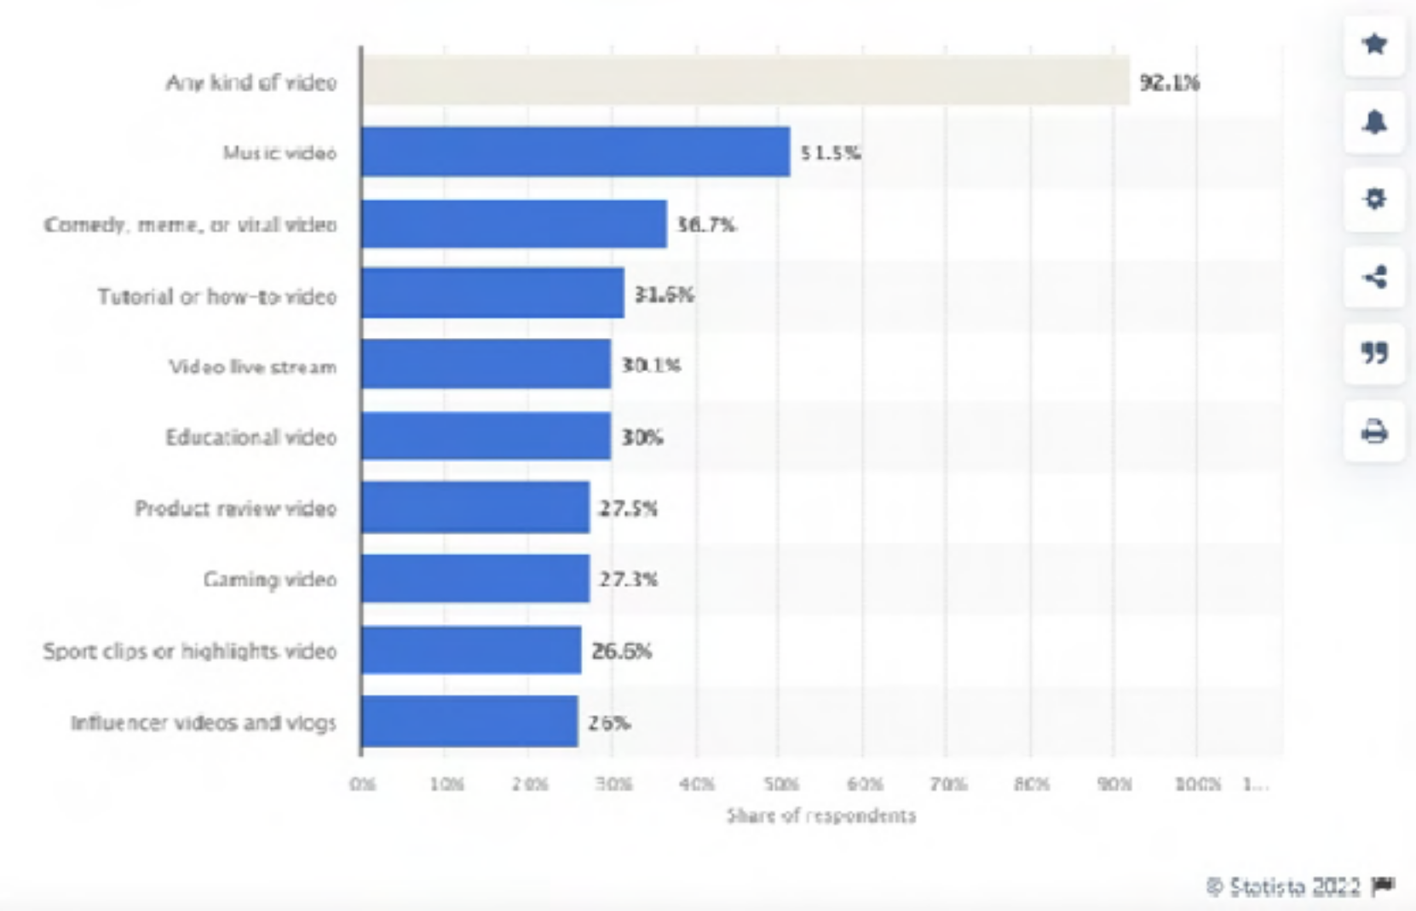
Market Landscape.
Professional content such as music and comedy continue to dominate user video consumption habits.
According to data collected by Statista, there were over three billion internet users watching streaming or downloaded video at least once per month in 2022. This number is projected to increase annually, ultimately reaching nearly 3.5 billion by 2023. In the U.S. alone, there were approximately
244.4 million video viewers in 2020. Source: Statista 2022
Proving the popularity of video content, Cisco reports that 82% of global internet trafﬁc will come from either video streaming or video downloads in 2022.Source: Cisco 2022

Slide 10
It's now projected that $130.5 billion of total social media ad spending will be generated through mobile by 2027.
Source Sprout Social
Market Landscape.
Market Research shows that users demonstrate a willingness to use a variety of social networks.
In 2023, there are estimated to be 4.89 billion total social media users worldwide.
Source: Hootsuite’s Digital Trends Report 2022
The average person bounces between seven different social networks per month.
Source: Hootsuite’s Digital Trends Report 2022
Users are spending increasingly more time on social media and the pot of advertising dollars is increasing signiﬁcantly.
The amount of time internet users spend on social media is now higher than ever — 151 minutes per day.
Source: Hootsuite’s Digital Trends Report 2022
The main reasons people use social media is to stay in touch with friends and family, ﬁll spare time, and read the news.
Source: Hootsuite’s Digital Trends Report 2022

Slide 11
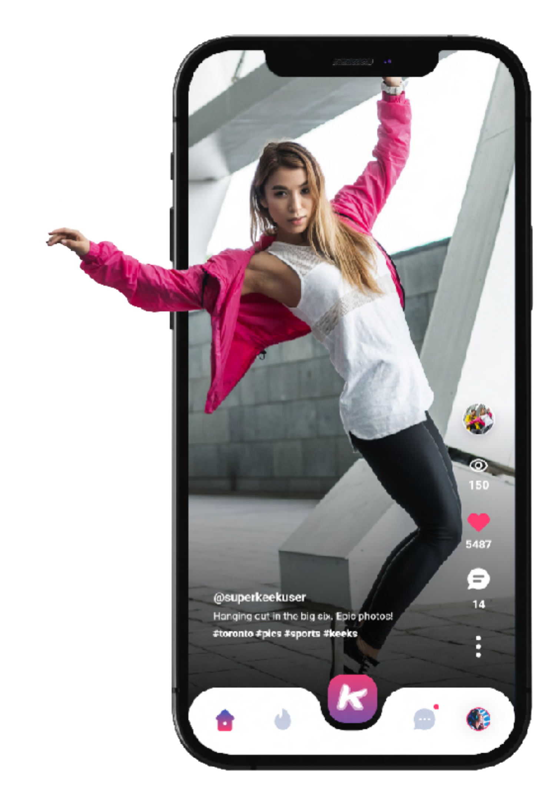
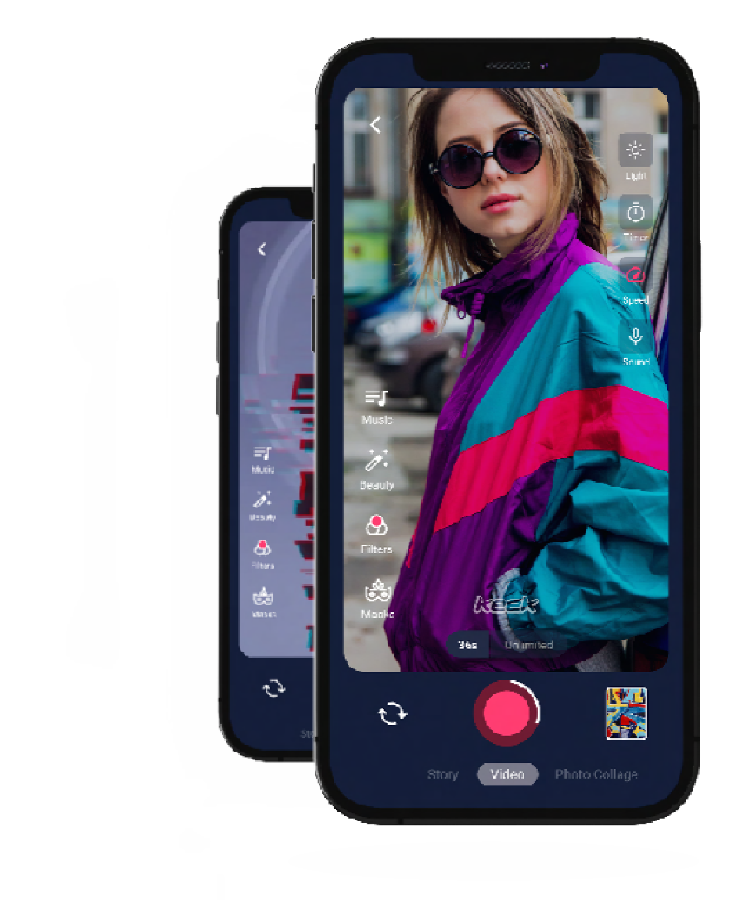
Marketing Overview.
Keek is still a well-known name that has 850K+ sites backlinking to Keek.com.
Our marketing efforts will consist of;
Market to its legacy userbase of 80 million people.
Market via social to its approximately 1.5 million followers and 2.5 million users of the company's other platforms.
Use AI based sentiment analysis to target market to users online. Contract a variety of inﬂuencers and celebrities to promote the app. Market in areas where TikTok is banned.
Market through traditional means such as product placement and sponsorships.

Slide 12
Contact Mark Itwaru, CEO
mark@keek.com
+1 647 789 0074

